Slide 1
CHAPTER 3
How Securities are Traded

Slide 2
How Firms Issue Securities
3-<number>
Primary Market
  Firms issue new securities through underwriter to public
  Investors get new securities; firm gets funding
Secondary Market
  Investors trade previously issued securities among themselves

Slide 3
How Firms Issue Securities (Ctd.)
3-<number>
Stocks
  IPO
  Seasoned offering
Bonds
  Public offering
  Private placement

Slide 4
Investment Banking
3-<number>
Underwriting: Investment bank helps the firm to issue and market new securities
Prospectus: Describes the issue and the prospects of the company.
  Red herring

Slide 5
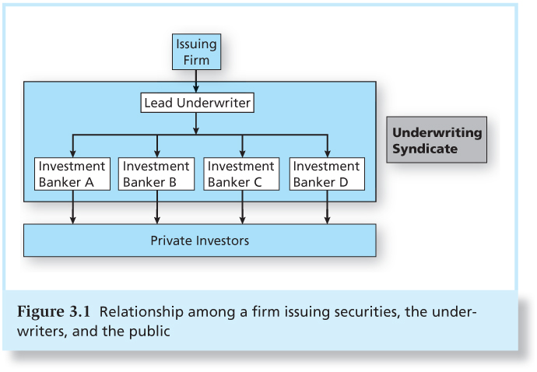
Figure 3.1 Relationship Among a Firm Issuing Securities, the Underwriters, and the Public
3-<number>

Slide 6
Investment Banking
3-<number>
Firm commitment
  investment bank purchases securities from the issuing company and then resells them to the public.
Shelf Registration
  SEC Rule 415: Allows firms to register securities and gradually sell them to the public for two years

Slide 7
Investment Banking (Ctd.)
3-<number>
Private placements
  Firm uses underwriter to sell securities to a small group of institutional or wealthy investors.
  Cheaper than public offerings
  Private placements not traded in secondary markets

Slide 8
Initial Public Offerings
3-<number>
Process
  Road shows to publicize new offering
  Bookbuilding to determine demand for the new issue
  Degree of investor interest in the new offering provides valuable pricing information

Slide 9
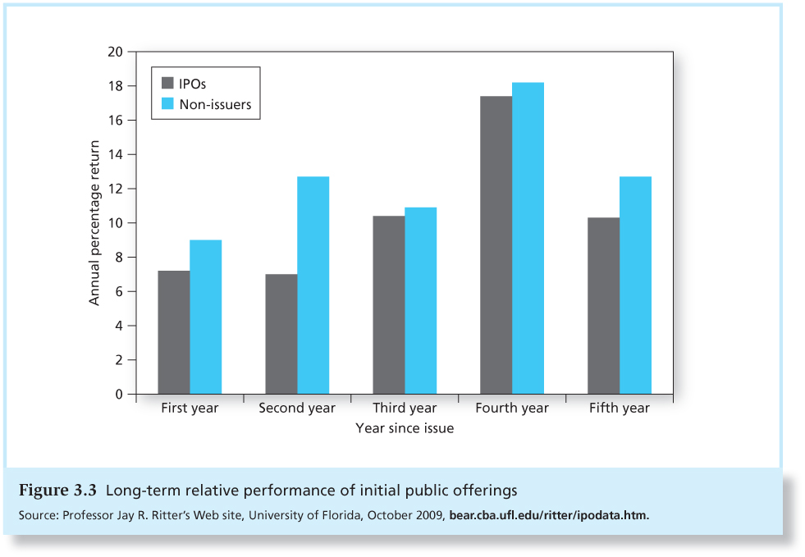
Figure 3.3 Long-term Relative Performance of Initial Public Offerings
3-<number>

Slide 10
How Securities are Traded
3-<number>
Types of Markets:
Direct search
  Buyers and sellers seek each other
Brokered markets
  Brokers search out buyers and sellers

Slide 11
How Securities are Traded
3-<number>
Types of Markets:
Dealer markets
  Dealers have inventories of assets from which they buy and sell
Auction markets
  traders converge at one place to trade

Slide 12
Bid and Asked Prices
3-<number>
Bid Price
Ask Price
Bids are offers to buy.
In dealer markets, the bid price is the price at which the dealer is willing to buy.
Investors “sell to the bid”.
Bid-Asked spread is the profit for making a market in a security.
Asked prices represent offers to sell.
In dealer markets, the asked price is the price at which the dealer is willing to sell.
Investors must pay the asked price to buy the security.

Slide 13
Types of Orders
3-<number>
Market Order: Executed immediately
  Trader receives current market price
Price-contingent Order:
  Traders specify buying or selling price
A large order may be filled at multiple prices

Slide 14
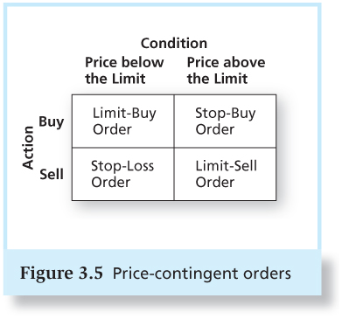
Figure 3.5 Price-Contingent Orders
3-<number>

Slide 15
Trading Mechanisms
3-<number>
Dealer markets
Electronic communication networks (ECNs)
  True trading systems that can automatically execute orders
Specialists markets
  maintain a “fair and orderly market”

Slide 16
NASDAQ
3-<number>
Lists about 3,200 firms
Originally, NASDAQ was primarily a dealer market with a price quotation system
Today, NASDAQ’s Market Center offers a sophisticated electronic trading platform with automatic trade execution.
Large orders may still be negotiated through brokers and dealers

Slide 17
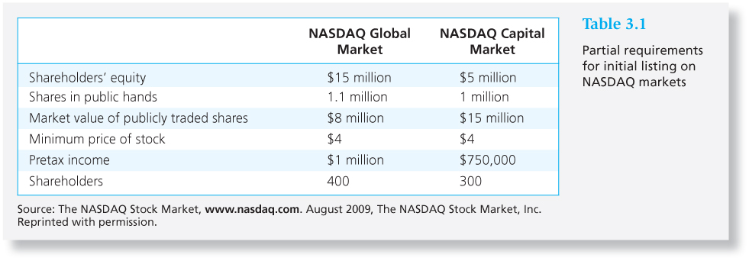
Table 3.1 Partial Requirements for Listing on NASDAQ Markets
3-<number>

Slide 18
New York Stock Exchange
3-<number>
Lists about 2,800 firms
Automatic electronic trading runs side-by-side with traditional broker/specialist system
  SuperDot : electronic order-routing system
  DirectPlus: fully automated execution for small orders
  Specialists: Handle large orders and maintain orderly trading

Slide 19
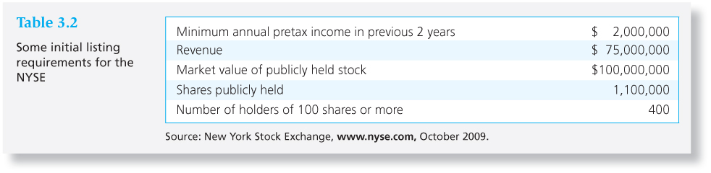
Table 3.2 Some Initial Listing Requirements for the NYSE
3-<number>

Slide 20
Electronic Communication Networks
3-<number>
ECNs: Private computer networks that directly link buyers with sellers for automated order execution
Major ECNs include NASDAQ’s Market Center, ArcaEx, Direct Edge, BATS, and LavaFlow.
“Flash Trading”: Computer programs look for even the smallest mispricing opportunity and execute trades in tiny fractions of a second.

Slide 21
Bond Trading
3-<number>
Most bond trading takes place in the OTC market among bond dealers.
Market for many bond issues is “thin”.
NYSE is expanding its bond-trading system.
  NYSE Bonds is the largest centralized bond market of any U.S. exchange

Slide 22
Market Structure in Other Countries
3-<number>
London - predominately electronic trading
Euronext – market formed by combination of the Paris, Amsterdam and Brussels exchanges, then merged with NYSE
Tokyo Stock Exchange

Slide 23
Globalization and Consolidation of Stock Markets
3-<number>
NYSE mergers and acquisitions:
  Archipelago (ECN)
  American Stock Exchange
  Euronext
NASDAQ mergers and acquisitions:
  Instinet/INET (ECN)
  Boston Stock Exchange

Slide 24
Globalization and Consolidation of Stock Markets
3-<number>
Chicago Mercantile Exchange acquired:
  Chicago Board of Trade
  New York Mercantile Exchange

Slide 25
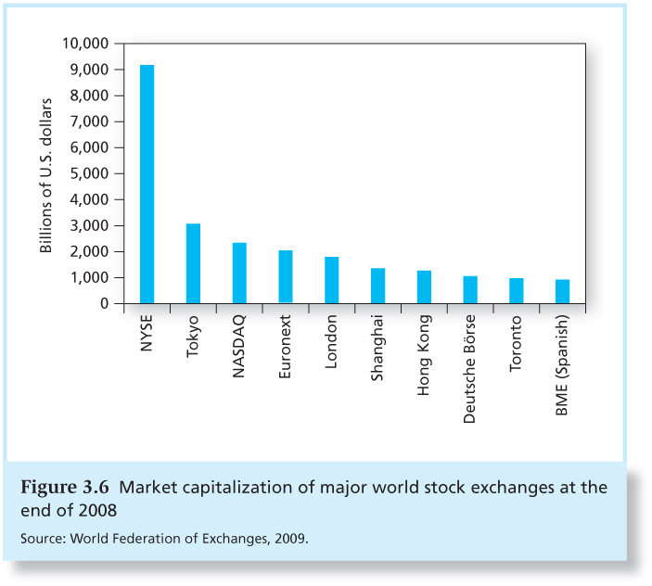
Figure 3.6 Market Capitalization of Major World Stock Exchanges, 2007
3-<number>

Slide 26
Trading Costs
3-<number>
Brokerage Commission: fee paid to broker for making the transaction
  Explicit cost of trading
  Full Service vs. Discount brokerage
Spread: Difference between the bid and asked prices
  Implicit cost of trading

Slide 27
Buying on Margin
3-<number>
Borrowing part of the total purchase price of a position using a loan from a broker.
Investor contributes the remaining portion.
Margin refers to the percentage or amount contributed by the investor.
You profit when the stock appreciates.

Slide 28
Buying on Margin (Ctd.)
3-<number>
Initial margin is set by the Fed
  Currently 50%
Maintenance margin
  Minimum equity that must be kept in the margin account
  Margin call if value of securities falls too much

Slide 29
Margin Trading:
Initial Conditions Example 3.1
3-<number>
Share price $100
60% Initial Margin
40% Maintenance Margin
100 Shares Purchased
Initial Position
Stock $10,000 Borrowed $4,000
Equity $6,000

Slide 30
Maintenance Margin Example 3.1
3-<number>
Stock price falls to $70 per share
New Position
Stock $7,000 Borrowed $4,000
Equity $3,000
Margin% = $3,000/$7,000 = 43%

Slide 31
Margin Call Example 3.2
3-<number>
How far can the stock price fall before a
margin call? Let maintenance margin = 30%
Equity = 100P - $4000
Percentage margin = (100P - $4,000) / 100P
(100P - $4,000) / 100P = 0.30
Solve to find:
P = $57.14

Slide 32
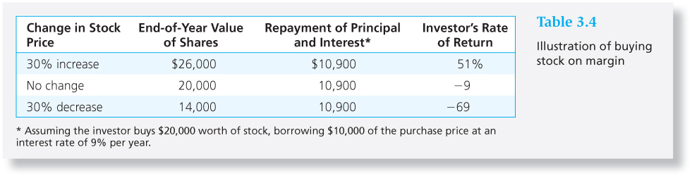
Table 3.4 Illustration of Buying Stock on Margin
3-<number>

Slide 33
Short Sales
3-<number>
Purpose: to profit from a decline in the price of a stock or security
Mechanics
  Borrow stock through a dealer
  Sell it and deposit proceeds and margin in an account
  Closing out the position: buy the stock and return to the party from which it was borrowed

Slide 34
Short Sale:
Initial Conditions Example 3.3
3-<number>
Dot Bomb 1000 Shares
50% Initial Margin
30% Maintenance Margin
$100 Initial Price
Sale Proceeds $100,000
Margin & Equity $50,000
Stock Owed 1000 shares

Slide 35
Example 3.3 (Ctd.)
Dot Bomb falls to $70 per share
3-<number>
Assets
Liabilities
$100,000 (sale proceeds)
$50,000 (initial margin)
$70,000 (buy shares)
Equity
$80,000
Profit = ending equity – beginning equity
= $80,000 - $50,000 = $30,000
= decline in share price x number of shares sold short

Slide 36
Short Sale - Margin Call
3-<number>
How much can the stock price rise before a margin call?
($150,000* - 1000P) / (1000P) = 30%
P = $115.38
* Initial margin plus sale proceeds

Slide 37
Regulation of Securities Markets
3-<number>
Major regulations:
  Securities Act of 1933
  Securities Act of 1934
  Securities Investor Protection Act of 1970
Self-Regulation
  Financial Industry Regulatory Authority
  CFA Institute standards of professional conduct

Slide 38
Regulation of Securities Markets (Ctd.)
3-<number>
Sarbanes-Oxley Act
  Public Company Accounting Oversight Board
  Independent financial experts to serve on audit committees of boards of directors
  CEOs and CFOs personally certify firms’ financial reports
  Boards must have independent directors

Slide 39
Insider Trading
3-<number>
Officers, directors, major stockholders must report all transactions in firm’s stock
Insiders do exploit their knowledge
  Jaffe study:
  Inside buyers>inside sellers = stock does well
  Inside sellers>inside buyers = stock does poorly

